Slide 1
Lending Club Case Study
In this presentation, we explore how risk analytics in banking and financial services can be solved through EDA. We'll take a deep dive into the world of data-driven decision making.
Group Members
Rajesh S
Sankar

Slide 2
EDA Workflow Approach
01
Stage Data
02
Data Overview
03
Data Cleansing
04
Univariate Analysis
Workflow
05
Bivariate Analysis
06
Multivariate-analysis
07
Feature/Recommendation

Slide 3

You work for a consumer finance company which specialises in lending various types of loans to urban customers. When the company receives a loan application, the company has to make a decision for loan approval based on the applicant’s profile. Two types of risks are associated with the bank’s decision:
If the applicant is likely to repay the loan, then not approving the loan results in a loss of business to the company
If the applicant is not likely to repay the loan, i.e. he/she is likely to default, then approving the loan may lead to a financial loss for the company
Business Understanding
You work for a consumer finance company which specializes in lending various types of loans to urban customers. When the company receives a loan application, the company has to make a decision for loan approval based on the applicant’s profile. Two types of risks are associated with the bank’s decision:
If the applicant is likely to repay the loan, then not approving the loan results in a loss of business to the company
If the applicant is not likely to repay the loan, i.e. he/she is likely to default, then approving the loan may lead to a financial loss for the company
Loan accepted: If the company approves the loan, there are 3 possible scenarios described below:
Fully paid: Applicant has fully paid the loan (the principal and the interest rate)
Current: Applicant is in the process of paying the instalments, i.e. the tenure of the loan is not yet completed. These candidates are not labelled as 'defaulted'.
Charged-off: Applicant has not paid the instalments in due time for a long period of time, i.e. he/she has defaulted on the loan

Slide 4
The Importance of Understanding Risk Analytics in Banking and Financial Services
Minimising Losses
Data Utilization
Enhanced Customer Service
By understanding risk analytics, banks and financial services reduce the financial impact of loan defaulters, minimising losses and improving overall productivity.
Understanding risk analytics ensures that the banks and financial services effectively utilise data to ensure loan profitability, manage debt and credit risk, and comply with legal and regulatory guidelines.
By understanding risk analytics, businesses can enhance their customer service experience, providing personalisation, and ultimately building long-term customer satisfaction.

Slide 5
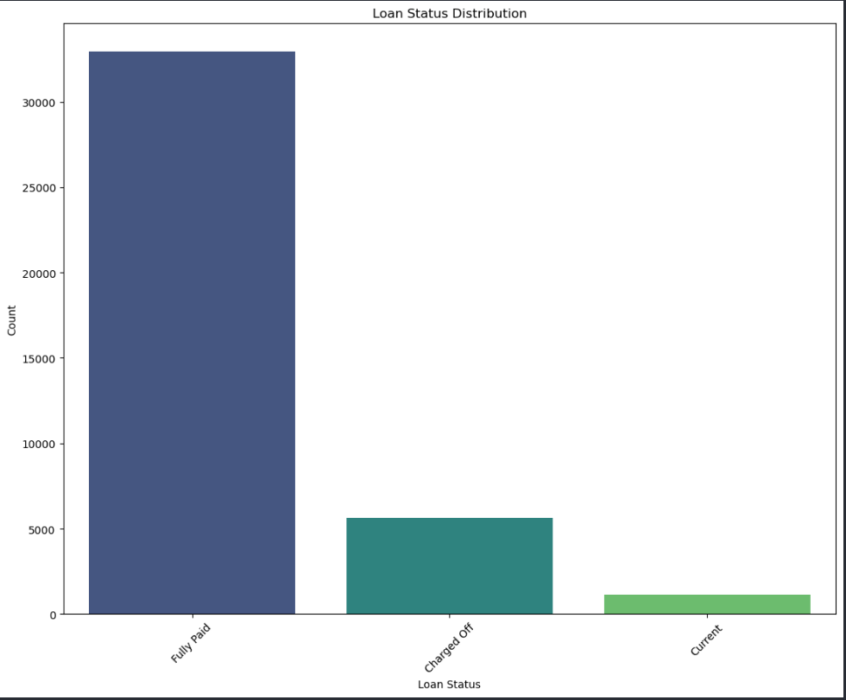
Data visualization to Minimise Lending Risk
Univariate

Slide 6
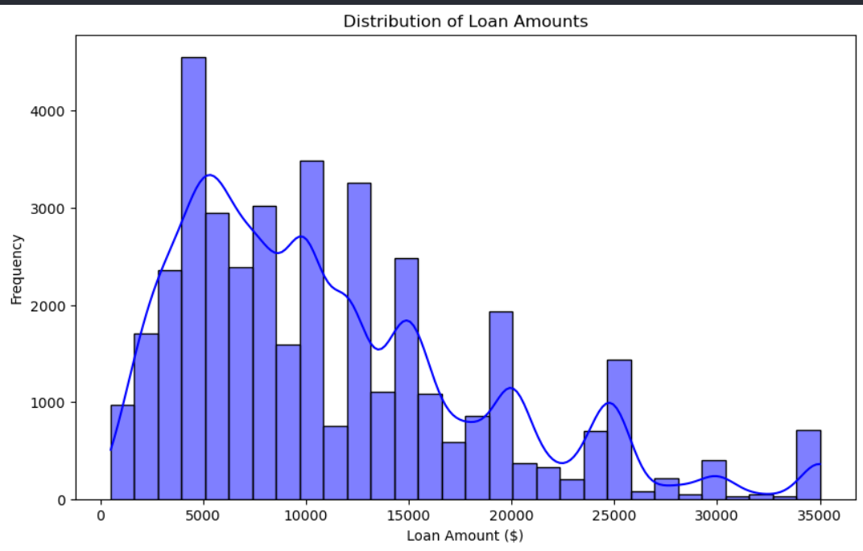
Distribution of Loan Amounts

Slide 7
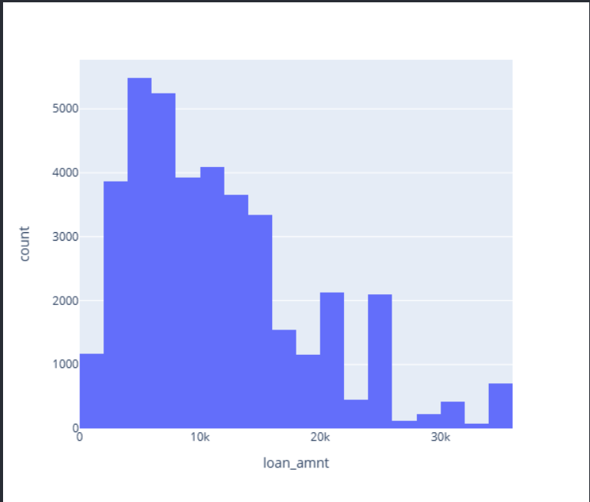
Distribution of Loan Amounts using Plotly

Slide 8
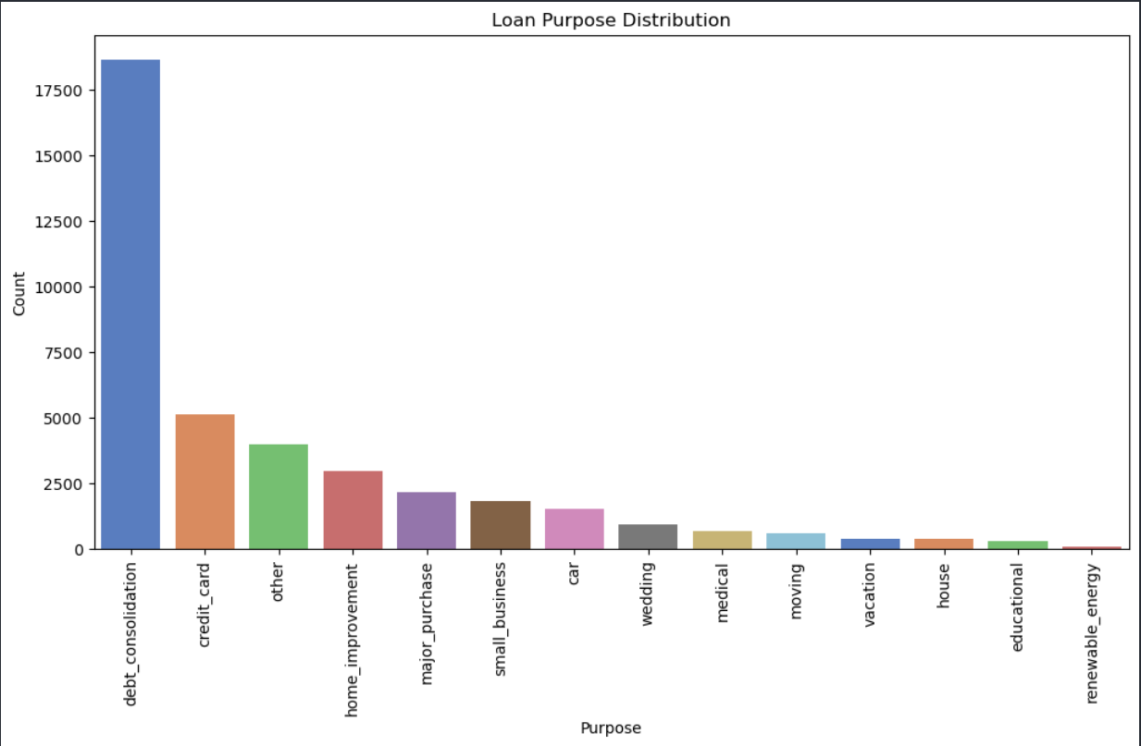
Loan Purpose Distribution

Slide 9
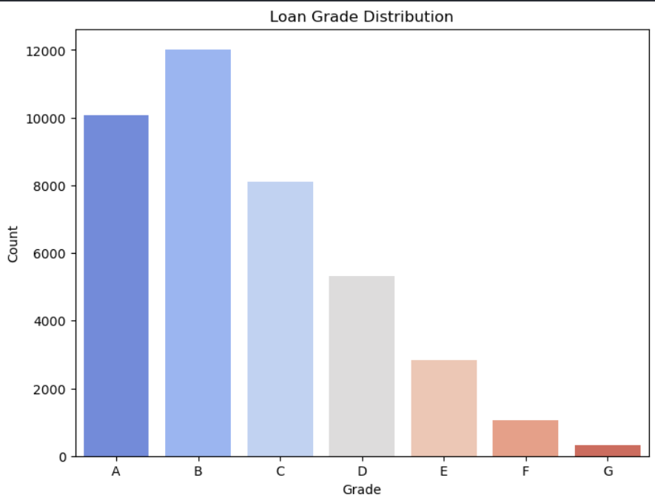
Grade Distribution

Slide 10
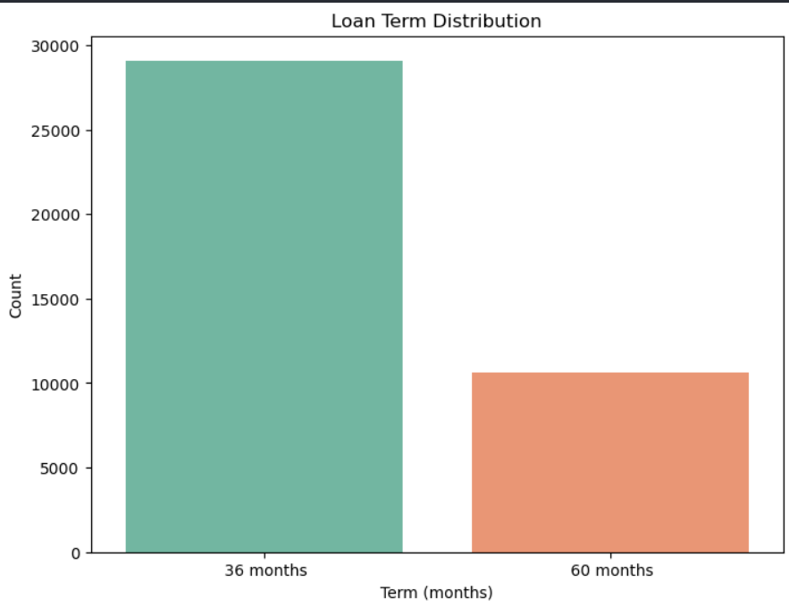
Loan Term Distribution

Slide 11
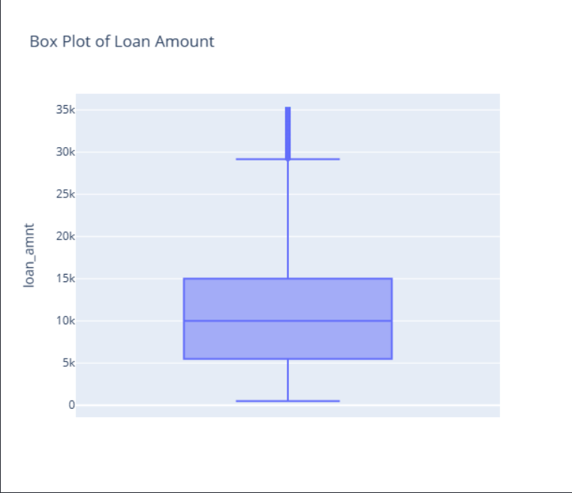
Box Plot

Slide 12
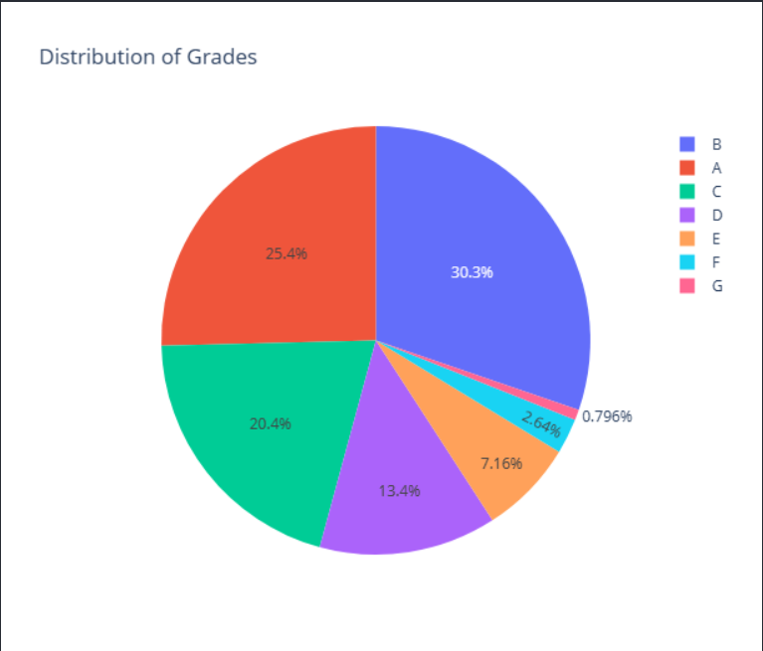
Pie for Grade distribution

Slide 13
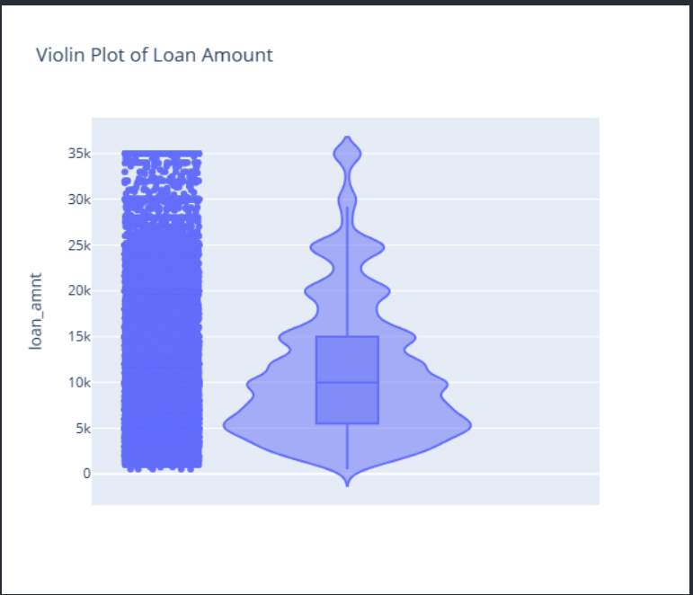
Violin graph for Loan Amount

Slide 14
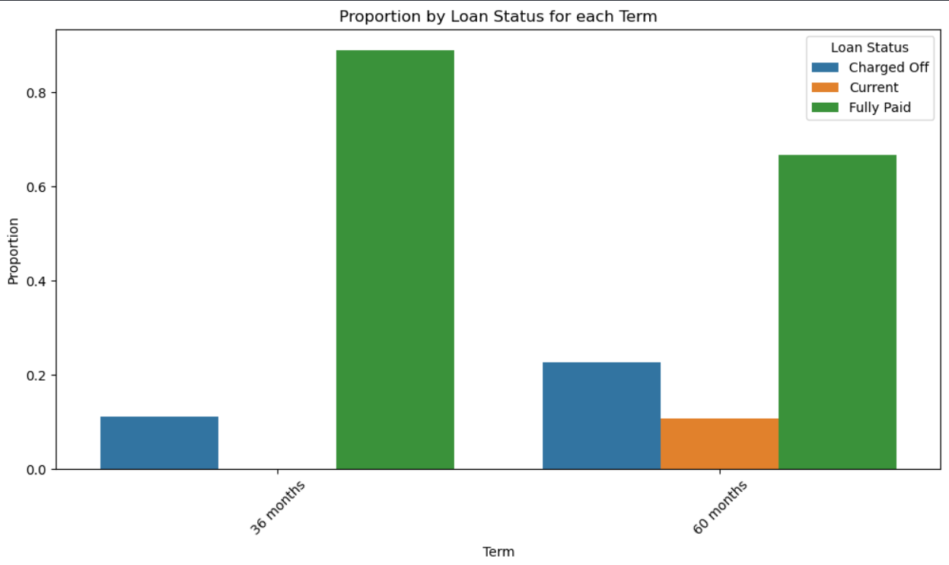
Bivariate
Default rate high in 60 months tenure

Slide 15
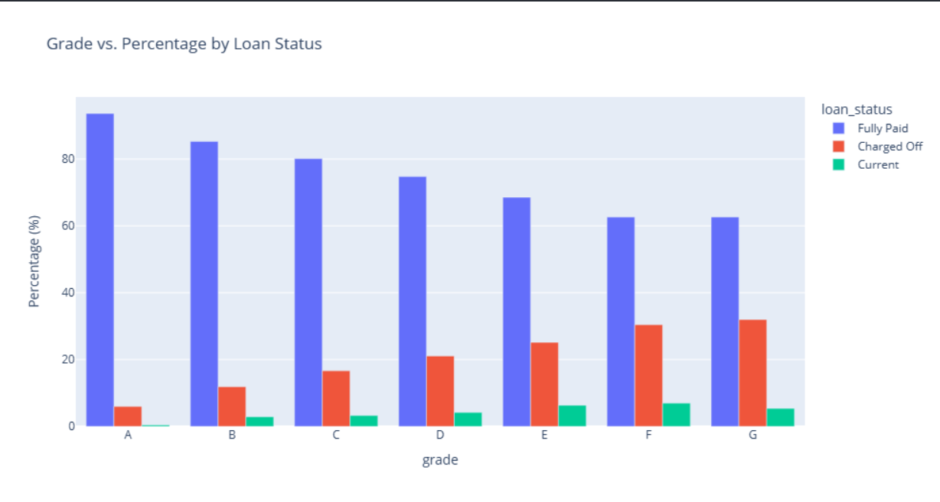
Bivariate
Default rate high for grades D,E,F,G

Slide 16

Bivariate
Default rate high in 60 Months Tenure.

Slide 17
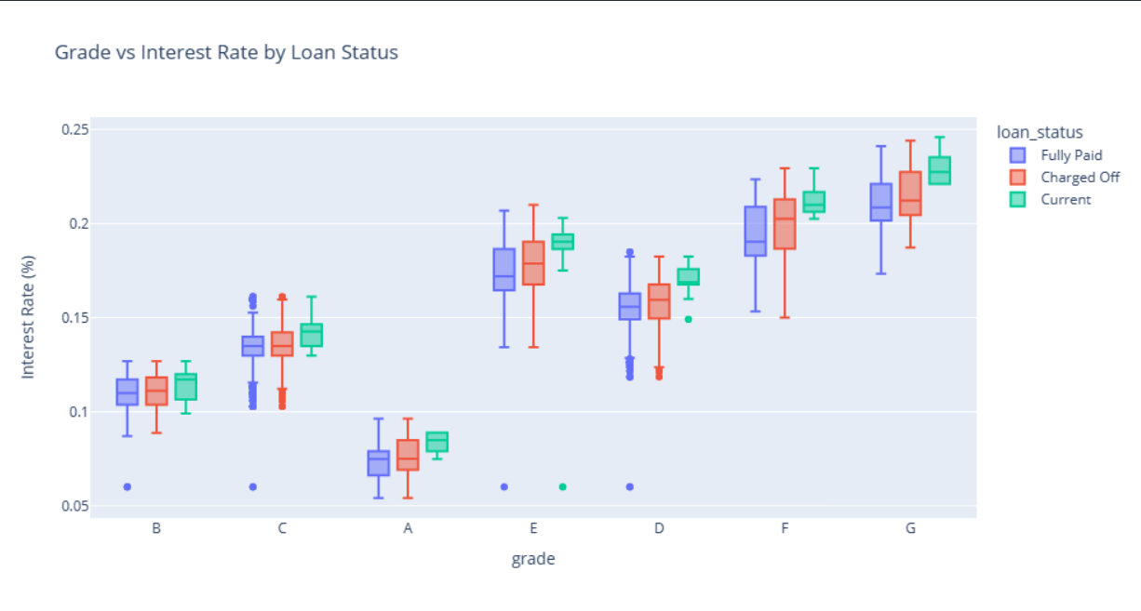
Bivariate
Grade E,F.G having higher Interest rates which could be the reason for charge off.

Slide 18
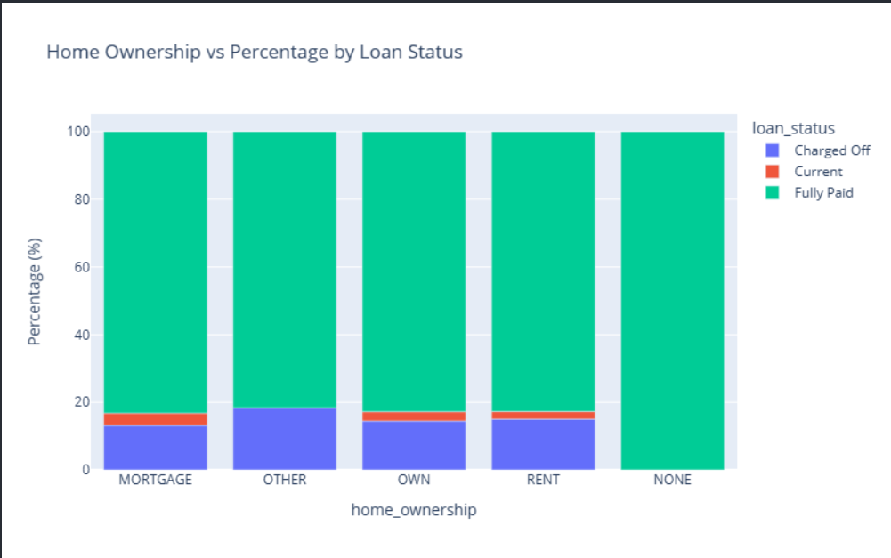
Bivariate
Home Ownership type other having more percentage of charge off followed by OWN and RENT

Slide 19
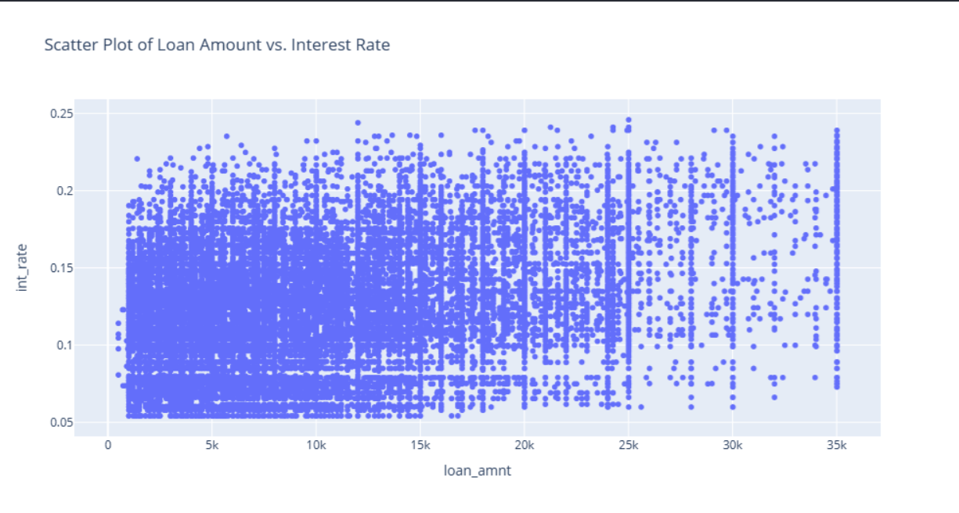
Bivariate
Interest Rate higher between 25K to 35K Loan amount

Slide 20
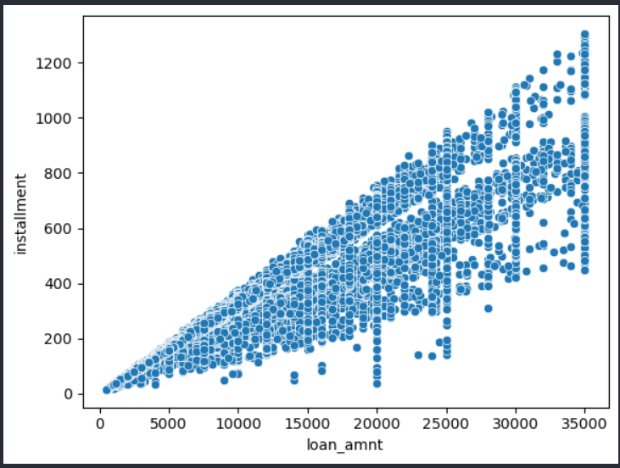
Bivariate
Higher the loan amount more is the installment

Slide 21
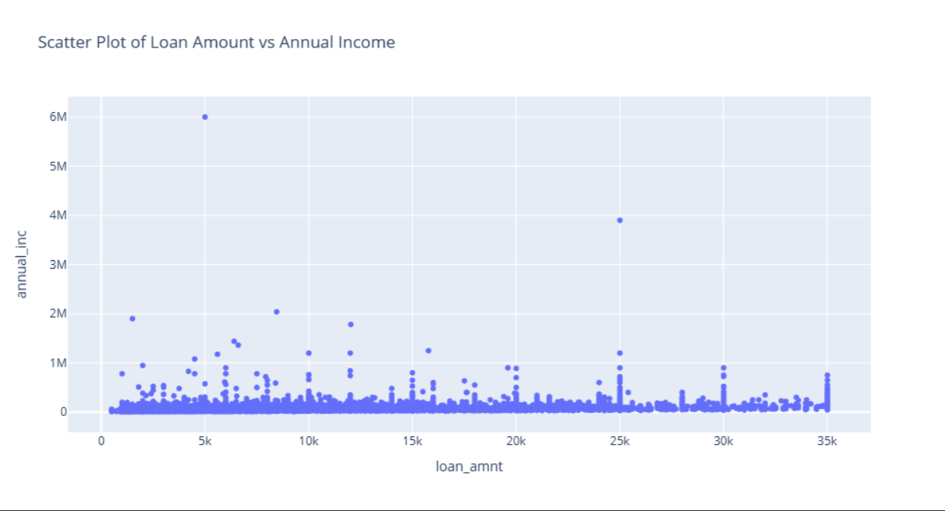
Bivariate
People with annual income more than 2m have rarely applied for loan

Slide 22
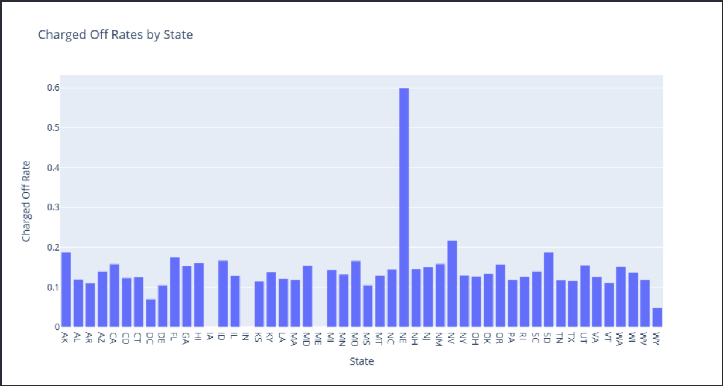
Bivariate
NE, AK, NV states having higher charge off rate

Slide 23
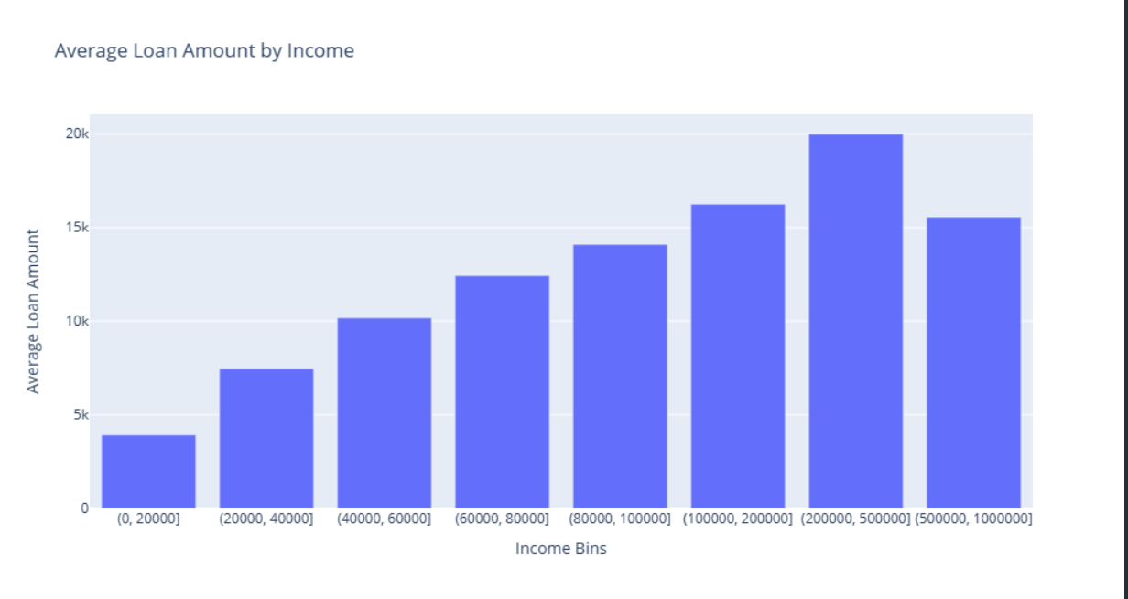
Bivariate
People in bin [200000,500000] have taken avg loan of 20 k which is highest compared to other bins

Slide 24
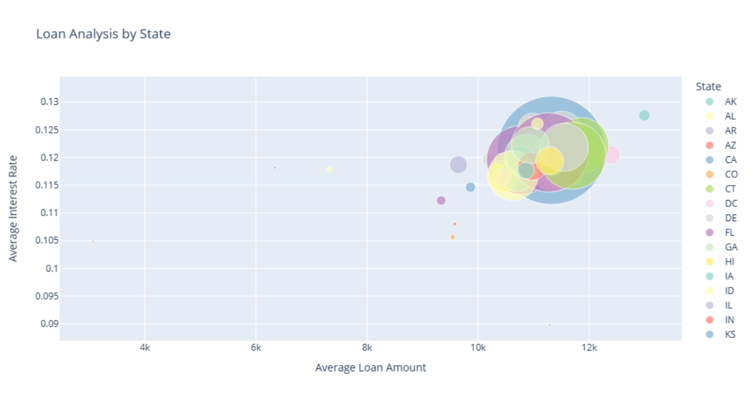
Bivariate
State CA has highest number of loans

Slide 25
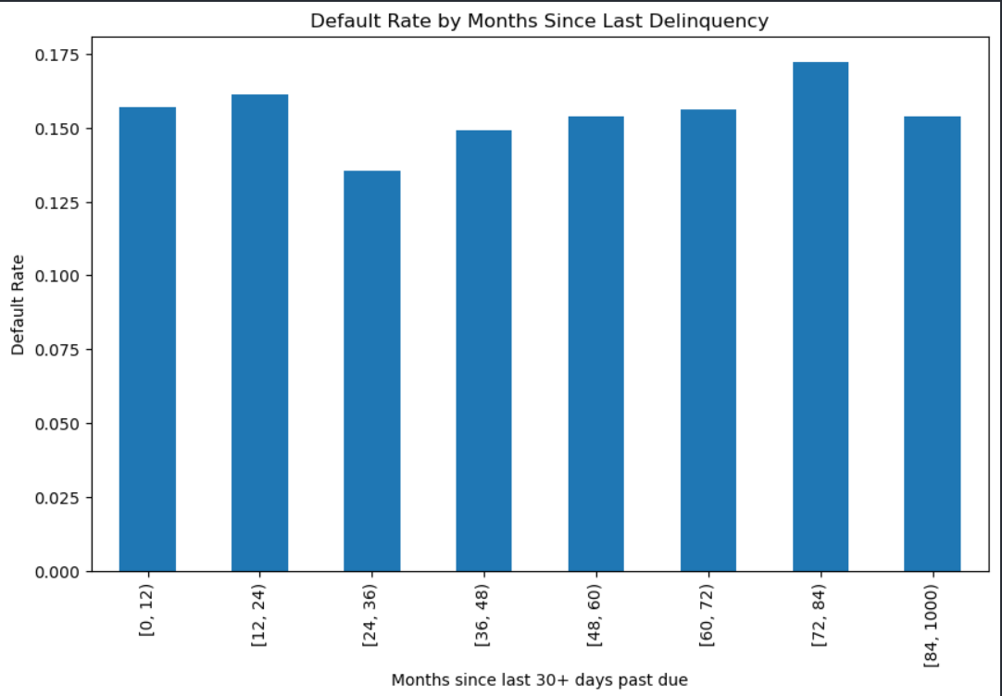
Bivariate
Helps to identify the risk associated with borrowers who had a history of delinquency

Slide 26
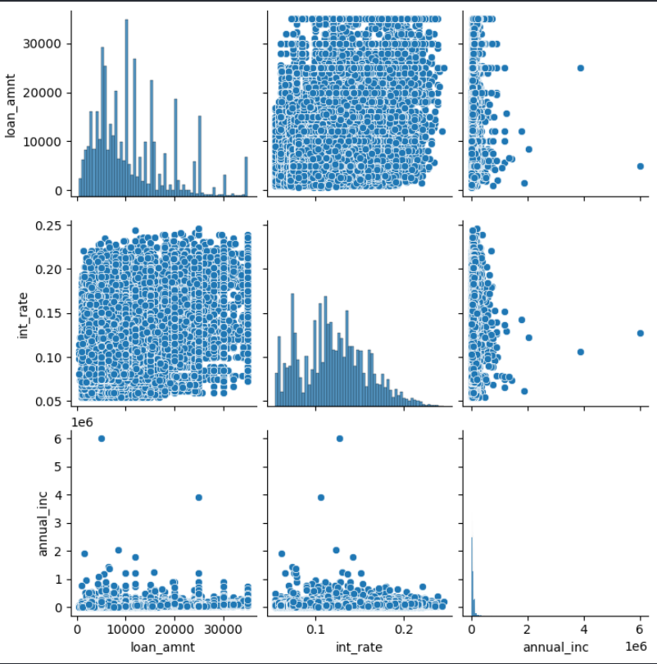
Bivariate
Pair Plot showing relationship between loan_amt, int_rate, and annual_inc

Slide 27
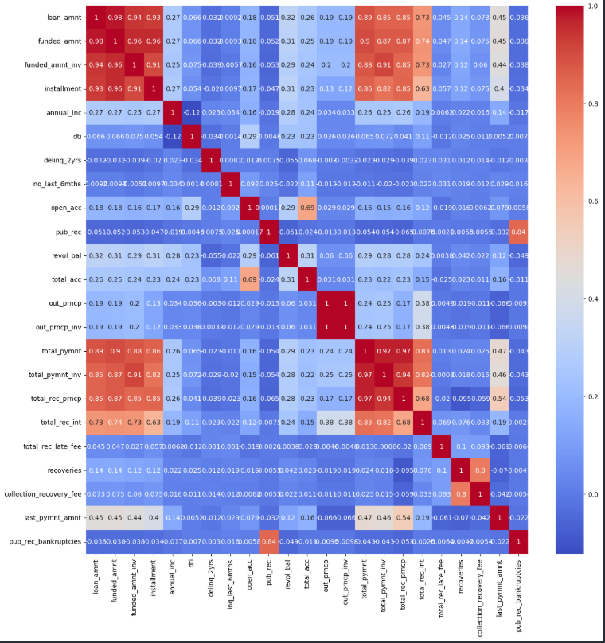
Multivariate
Shows highly correlated variables which help us in analysis

Slide 28
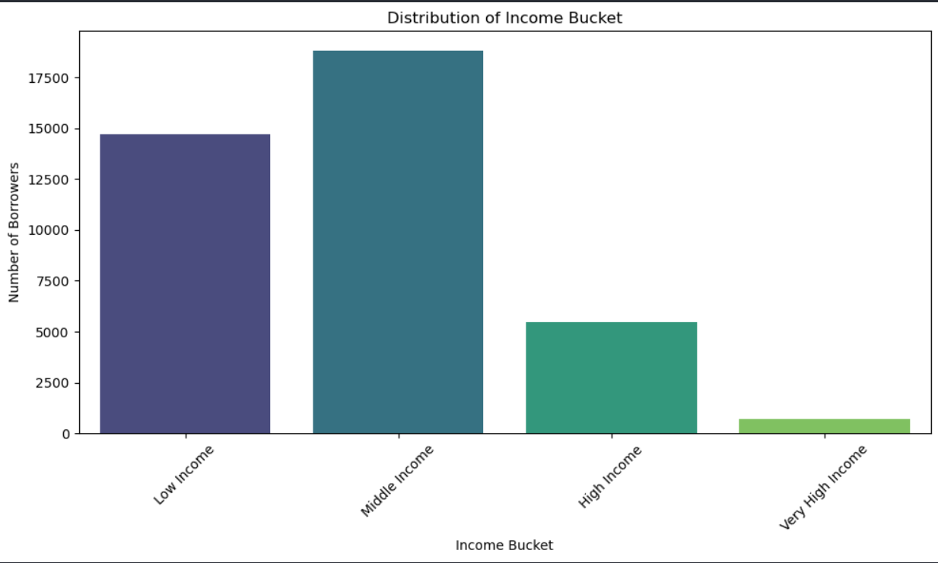
New Feature
People belonging to Middle income have taken more loan

Slide 29
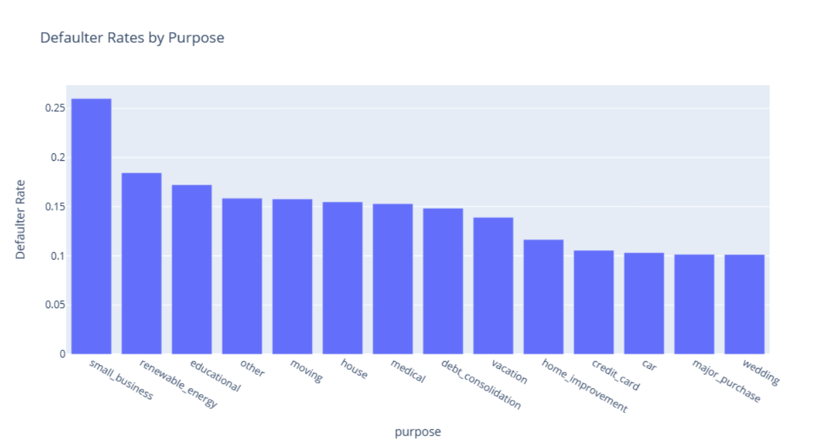
Findings
Small_business having more defaults

Slide 30
Conclusion
Default Rate more in small business
Default Rate more with 10+ Years experienced
Default Rate more in states like NE, NV , AK
Loan Terms High between 25 to 45 Months
Defaulters more in 60 months term.
Delinquency check important for loan processing along with Annual Income, Emp length
Recommendation
Reduce loan approvals in states like NE,NV,AK
Large loans should be avoided because of high risk.
Reduce Interest rate for small borrowers.

Slide 31
Thank You

